Slide 1
Applications of Fourier Transforms

Slide 2
Contents:
Introduction
Circuit analysis
Signal analysis and processing
Image processing
Conclusion

Slide 3
Introduction
We obtain Fourier Transform by a limiting process of Fourier series.
Fourier Transform decomposes any function into the sum of sinusoidal basis functions.
It is useful in almost every aspect of the subject ranging from solving LDE to developing computer models , to the processing & analysis of data.

Slide 4
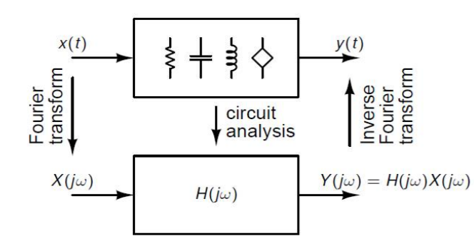
Circuit Analysis:
There are many linear circuits used in electronic engineering field.
These circuits include various components like capacitor, inductor, resistor etc.
Every Electronic circuit can be modelled using mathematical equations.
Where x(t)- actual signal applied as input to the circuit. y(t) – output of the circuit

Slide 5
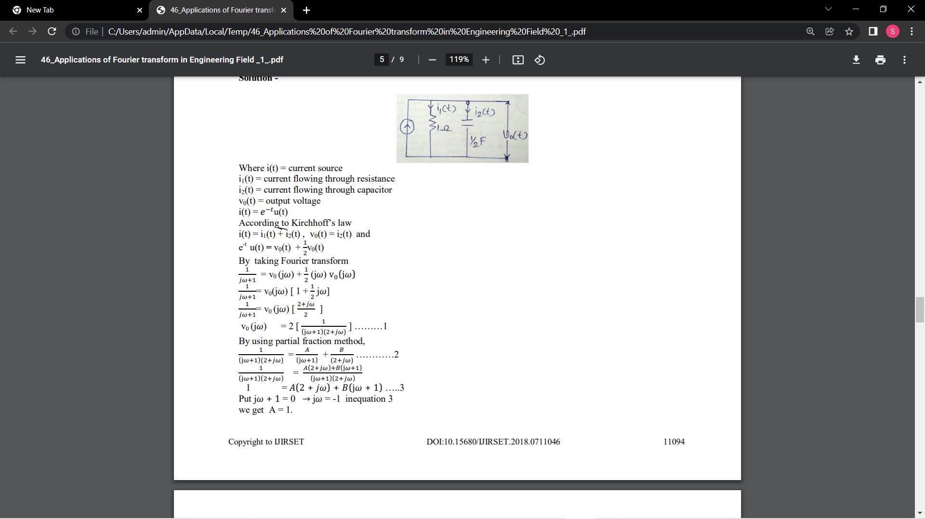
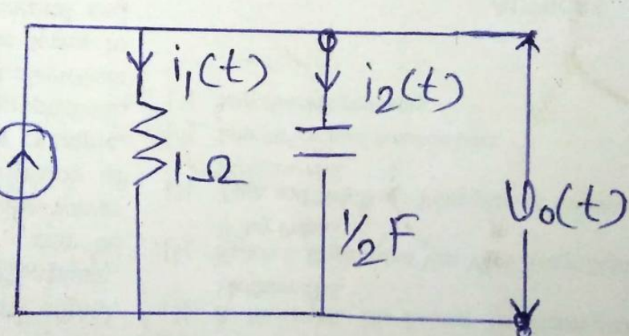
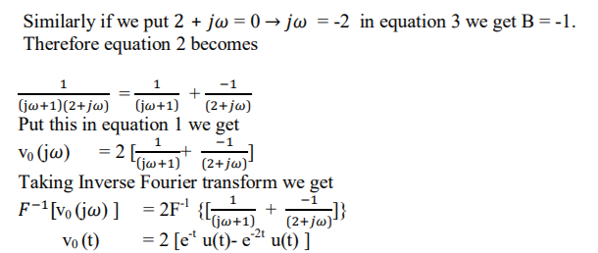
Let’s take an example. In this example we have to find output voltage v0 (t) by using Fourier transform.

Slide 6
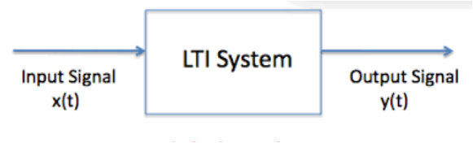
Signal analysis and processing
The Fourier Transform is extensively used in LTI system , filtering and signal processing
Signal can be defined as a variability of any physical value, that can be described as a function of a single or multiple arguments.
Suppose we have a system that accepts an input signal and produces an output signal from that. Such a box can be thought of as a system:

Slide 7
The reason for this goes back to the linearity of the Fourier Transform: the impulse in time can be thought of as an infinite sum of sinusoids at every possible frequency.
In fact, the majority of the analysis takes place in the frequency domain, making the understanding of Fourier Theory indispensable.
While this method is helpful in understanding the short time behaviour of the signal of interest, we are sometimes interested in frequency behaviour on longer time scales. Therefore, an alternate method called windowing is necessary.

Slide 8
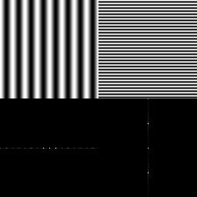
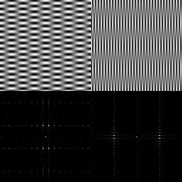
Image processing
The Fourier Transform is an important image processing tool which is used to decompose an image into its sine and cosine components.
The definitions of the transform (to expansion coefficients) and the inverse transform are given below:
F(u,v) = SUM{ f(x,y)*exp(-j*2*pi*(u*x+v*y)/N) }
and
f(x,y) = SUM{ F(u,v)*exp(+j*2*pi*(u*x+v*y)/N) }
where u = 0,1,2,...,N-1 and v = 0,1,2,...,N-1
x = 0,1,2,...,N-1 and y = 0,1,2,...,N-1 j = SQRT( -1 )
and SUM means double summation over proper x,y or u,v ranges

Slide 9
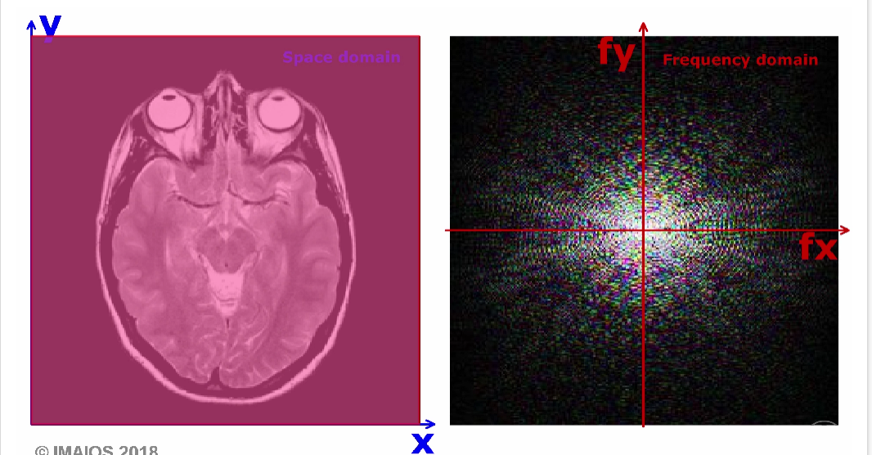
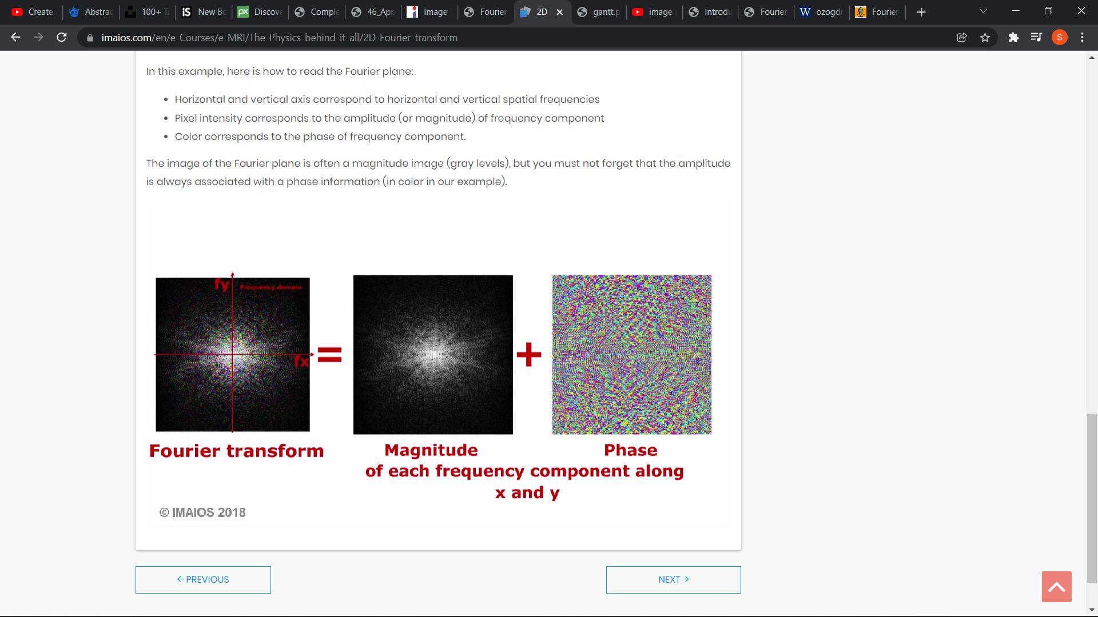
Applications in MRI and CT:
Fourier transform is integral to all modern imaging, and is particularly important in MRI.
The signal received at the detector (receiver coils in MRI and detector array in CT) is a complex periodic signal made of a large number of constituent frequencies (i.e., bandwidth).
This can be visualized as multiple sine and or cosine waves along a time-axis.
Fourier transform represents the same data over a frequency-axis.

Slide 10
Conclusion
Fourier Transform is useful in the study of solution of partial differential equation to solve initial boundary value problems.
A Fourier Transform when applied to partial differential equation reduces the number of independent variables by one.
We use Fourier Transform in signal &image processing. It is also useful in cell phones, LTI system and circuit analysis.
6

Slide 11
THANK YOU
Presented by:
Vijayalaxmi.S.Korti 2GI20CS178
Srushti B Mudennavar 2GI20CS158
Shradha M Patil 2GI20CS144

